Slide 1
Nimansa Publisher’s Book management system

Slide 2
Introduction
The owner of Nimansa Publishers is Mr. Wasantha Kumara Paranavithana. It has been 12 years since the Nimansa Publishing Company started. They publish comic books. They are the first publisher who publish comic books.
After 5 years they also attended the BMICH book fair. From then until now, they participate annually. They have already published about 300 comic books. Now a day Nimansa Publishers are famous publishing company in the country.

Slide 3

Login

Slide 4

Manager dashboard

Slide 5
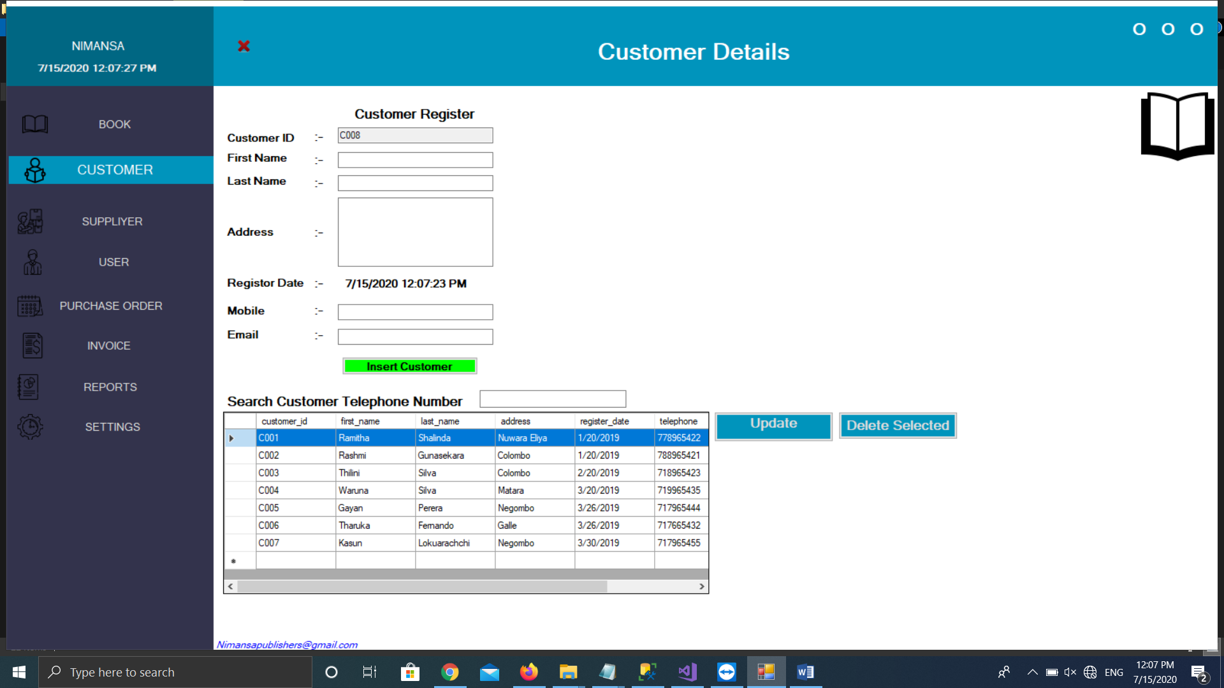
Register, update, delete customer

Slide 6
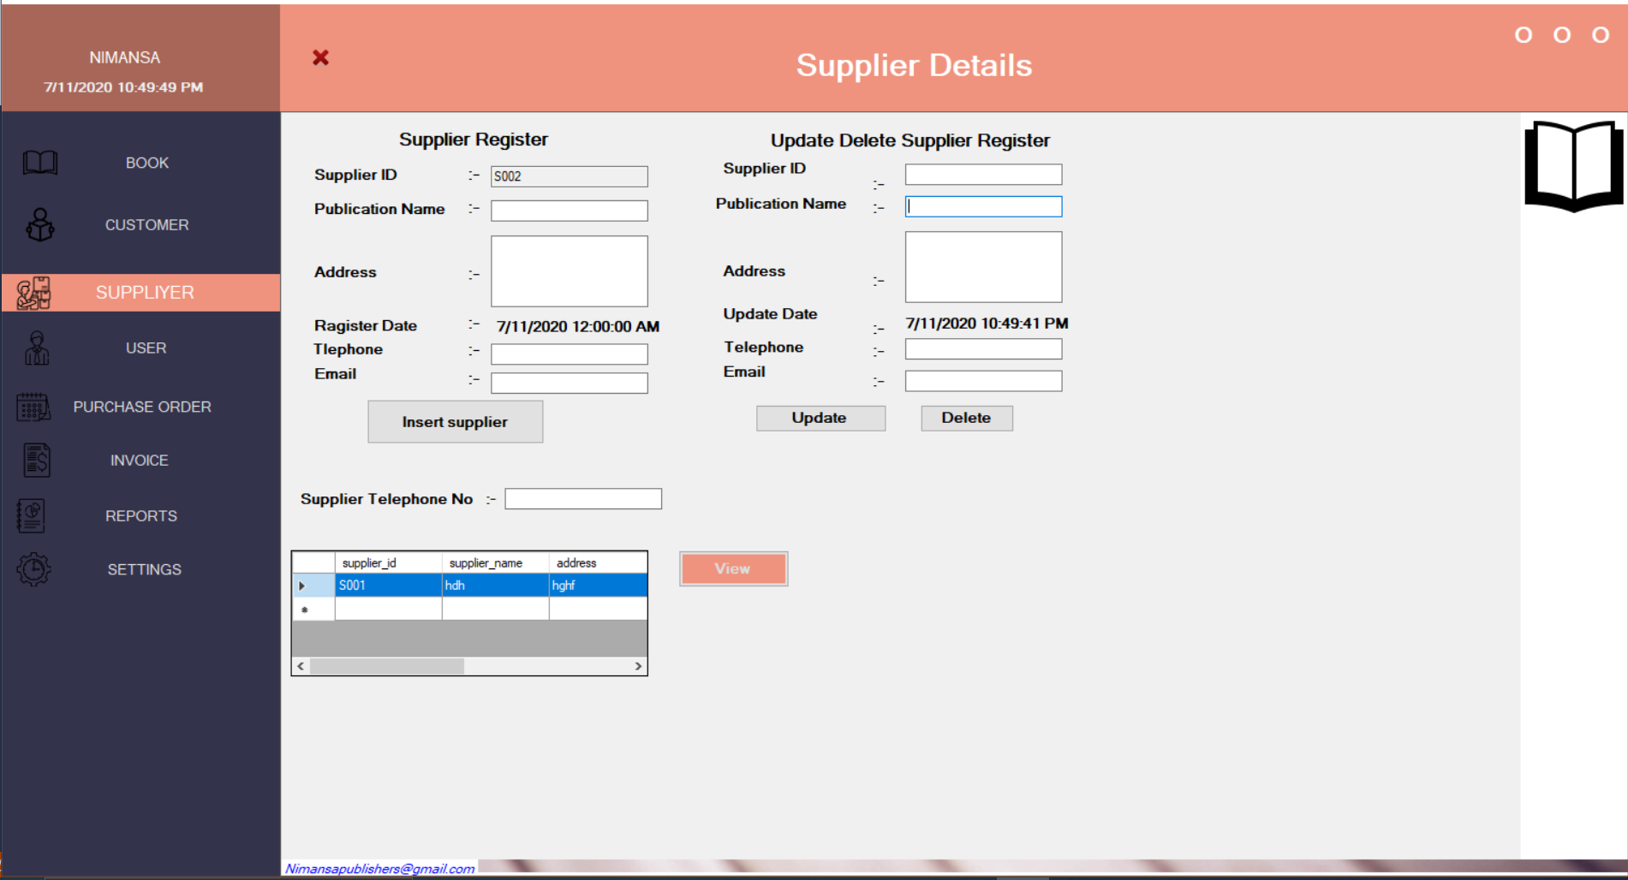
Register, update, delete SUPPLIER

Slide 7
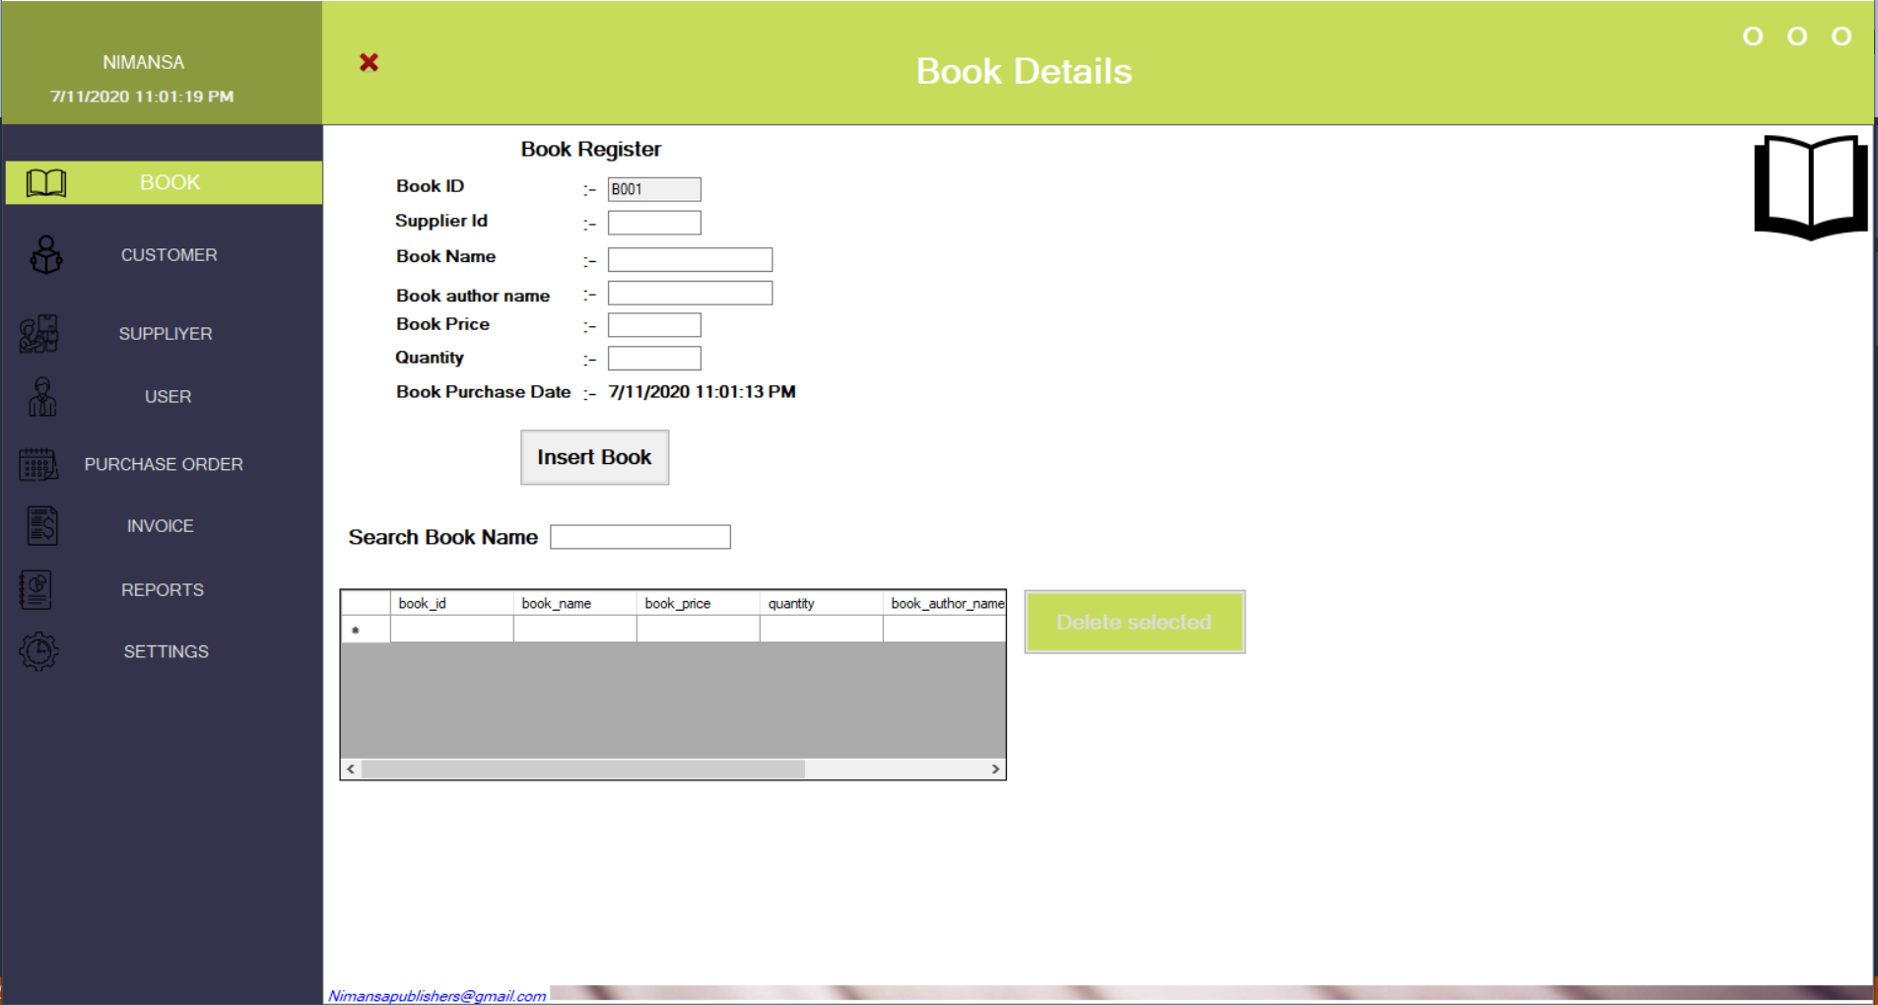
Register, delete BOOK

Slide 8
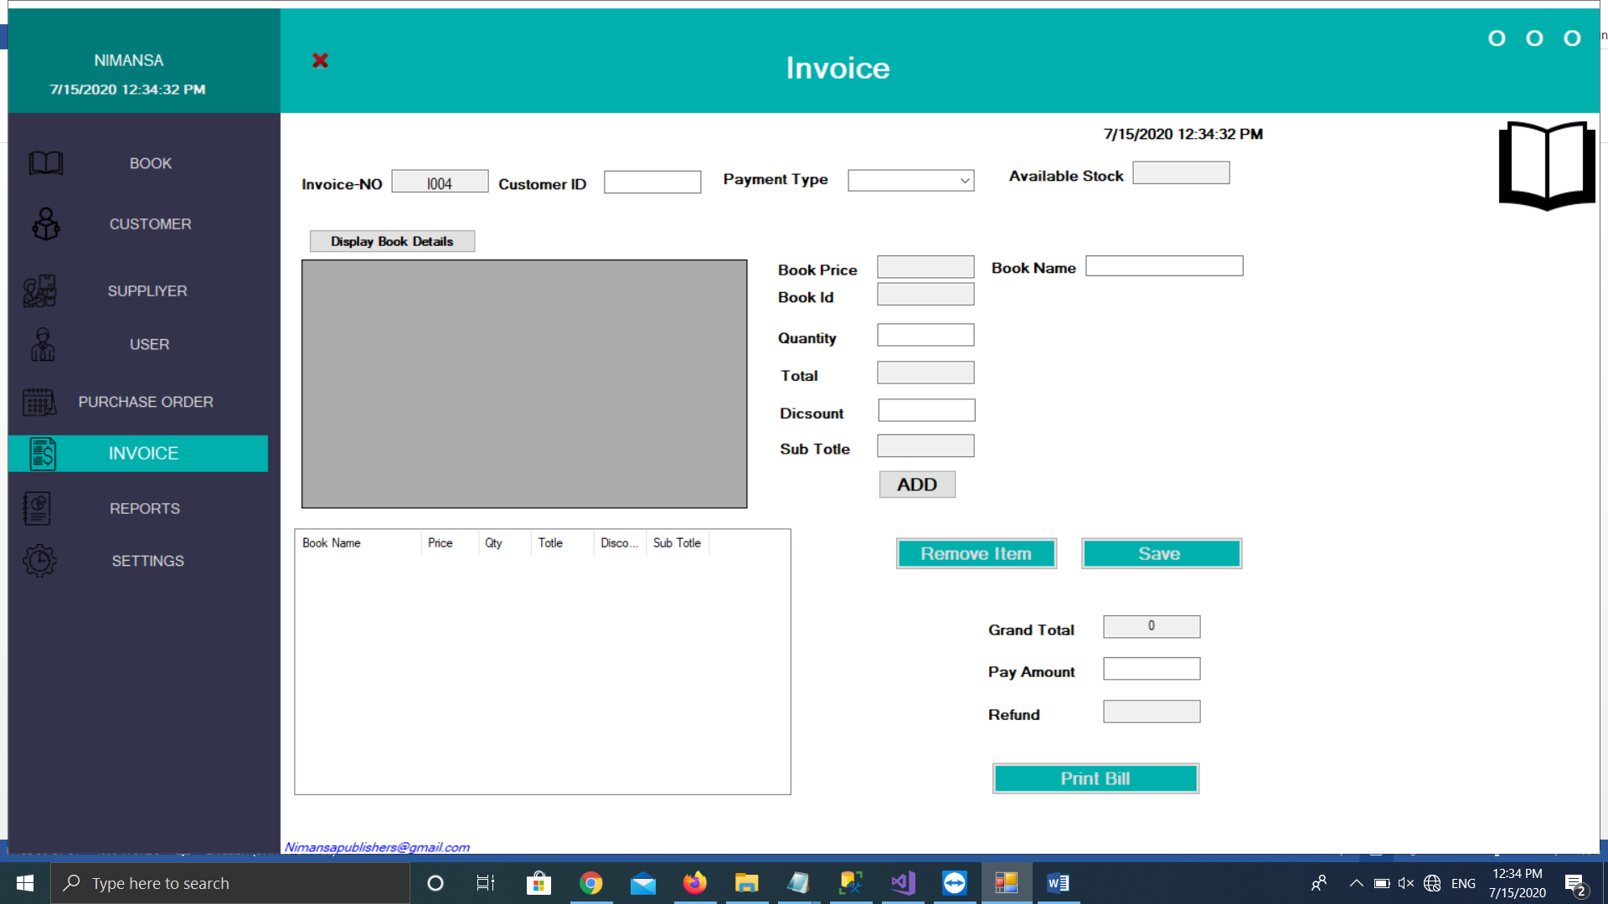
INVOICE

Slide 9
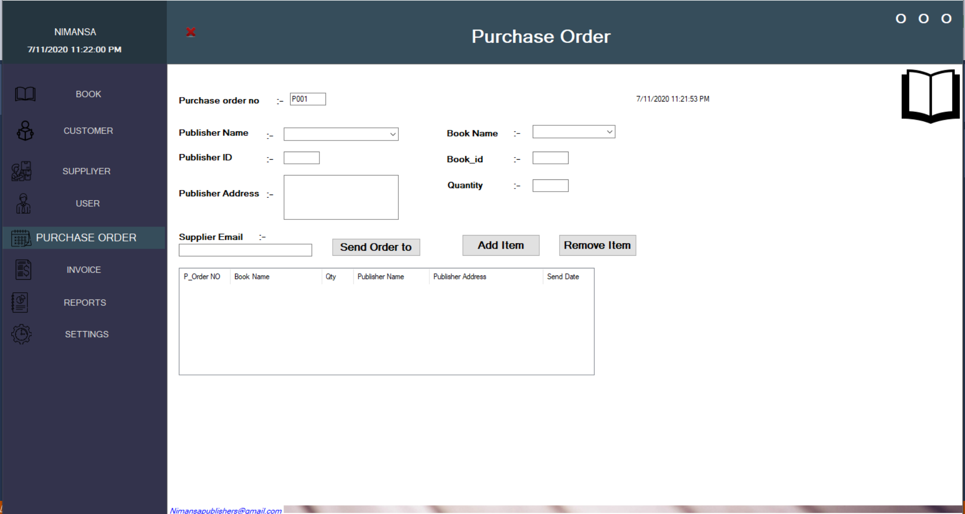
PURCHASE ORDER

Slide 10
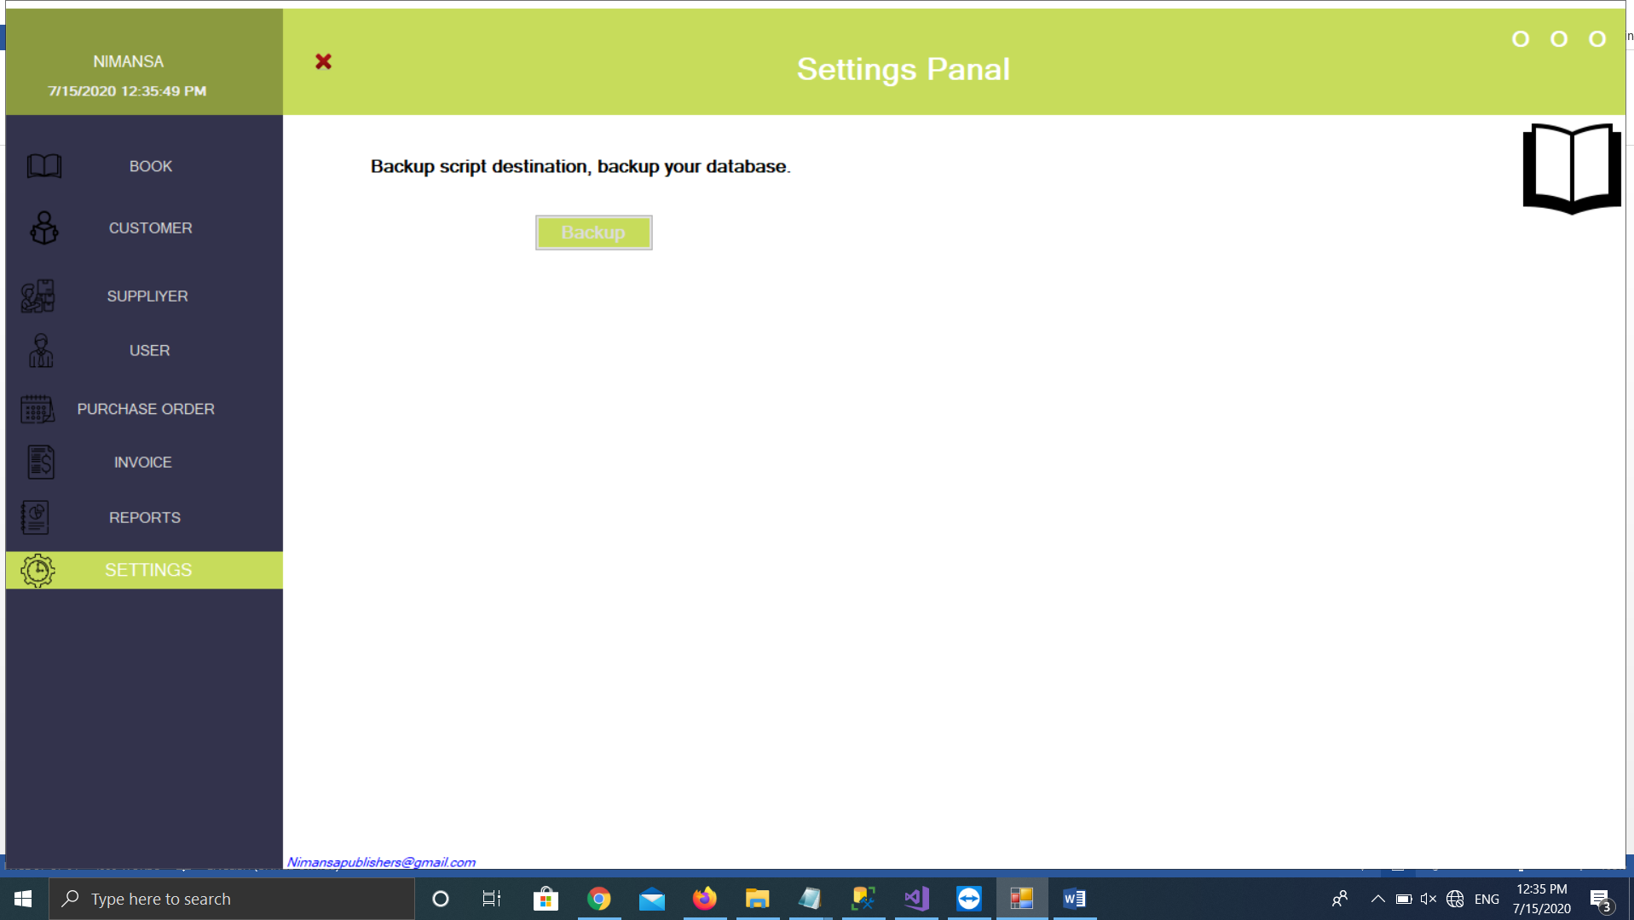
settings

Slide 11

Assistant dashboard

